Slide 1
Advanced Machine Learning: Deep Neural Networks
Week 2

Slide 2
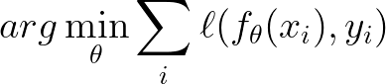
Function Approximation
This course will focus on learning objectives
E.g. supervised regression learning: optimize
In practice, we have to select f
We can select linear models, boosted trees etc.
Makes a big difference!

Slide 3
Deep neural networks
DNNs disrupted the classical ML paradigm on multiple levels
Deep architectures are not the focus of this course
In practice, DL will be used for implementing our ideas
This week will be devoted to an overview of DL

Slide 4
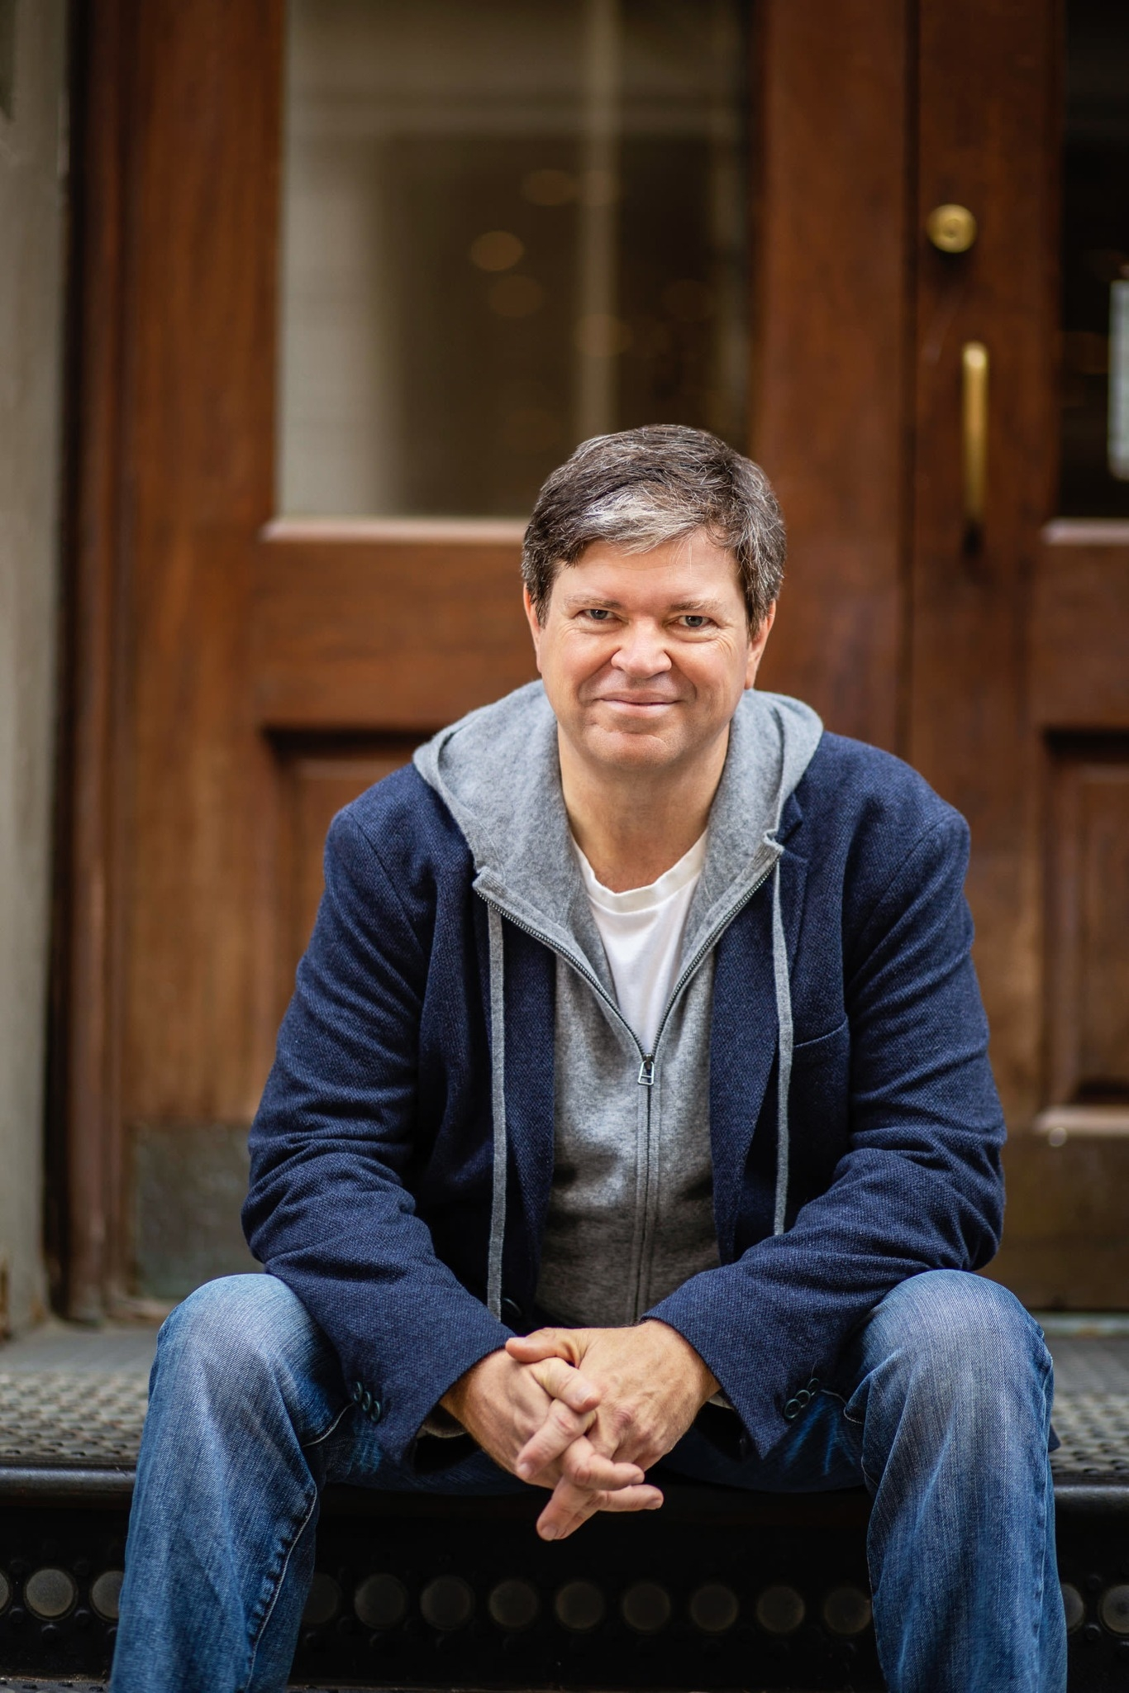
What is deep learning?
In the past: a neural network with >1 hidden layers
Yann Lecun: “DL is constructing networks of parameterized functional modules & training them from examples using gradient-based optimization. That's it. This definition is orthogonal to the learning paradigm: reinforcement, supervised, or self-supervised.”
Do you agree with Yann?

Slide 5
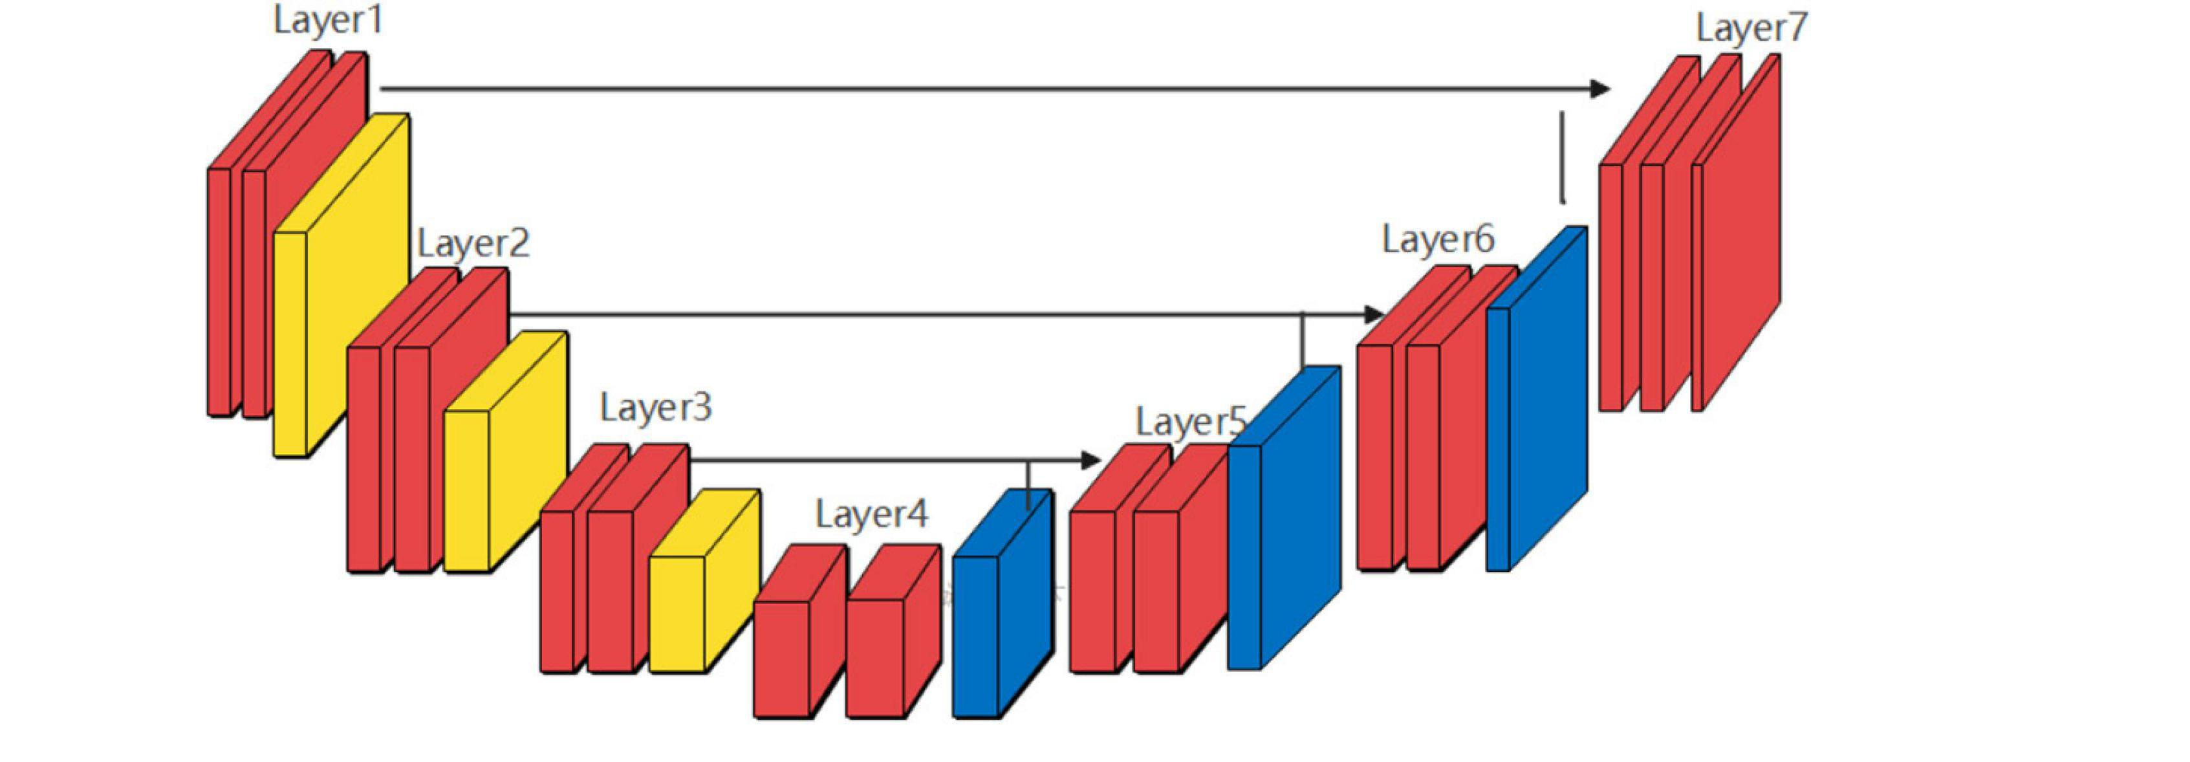
Deep learning architectures
DL combines simple operations with learned parameters
Combinations can be in series or parallel
Consider this architecture:

Slide 6
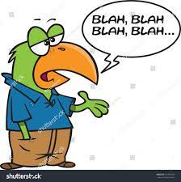
Expressivity
The required operation must be expressible by the network
Small networks may not approximate our desired task
Not just size, need to have the correct type of operations
Which operations are neural networks not good at?

Slide 7
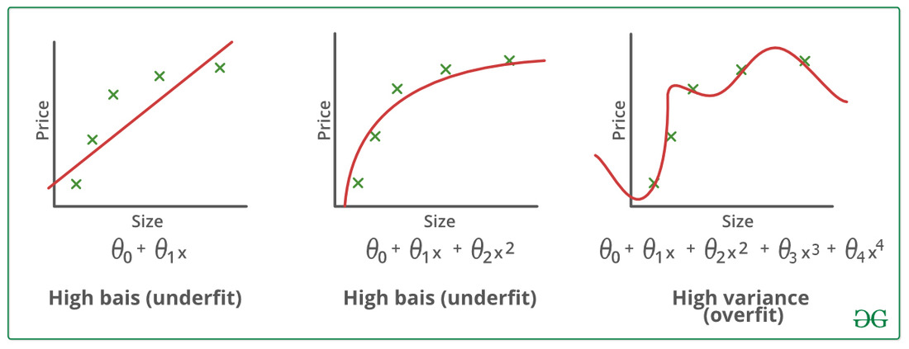
Design principles of deep NNs
Maximum expressivity: improving function approximation
Minimum unrequired parameters: reducing overfitting

Slide 8
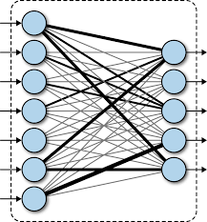
Fully-connected (FC) layer
Each layer processes data
It consist of a mathematical operation requiring parameters
Typically includes a non-linear component
Fully-connected (FC) layer + RELU: z <- Wx + b
ReLU non-linearity: z <- max(z, 0)
Why do we add a non-linearity?

Slide 9
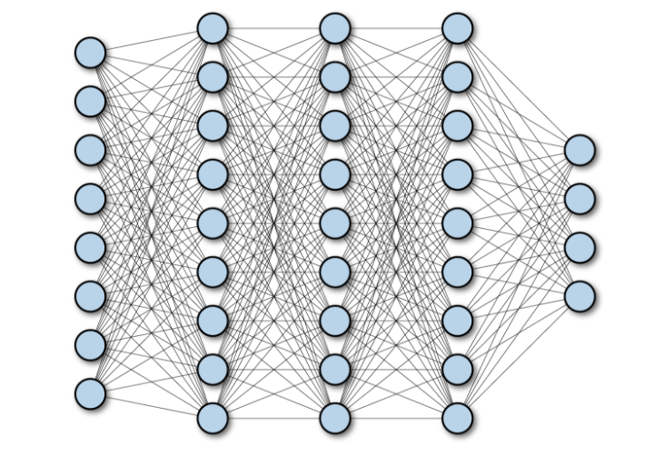
Stacking FC layers
A series of linear layers + ReLU
Depth: number of layers
Width: number of neurons per layer
Map initial datum to a powerful representation

Slide 10
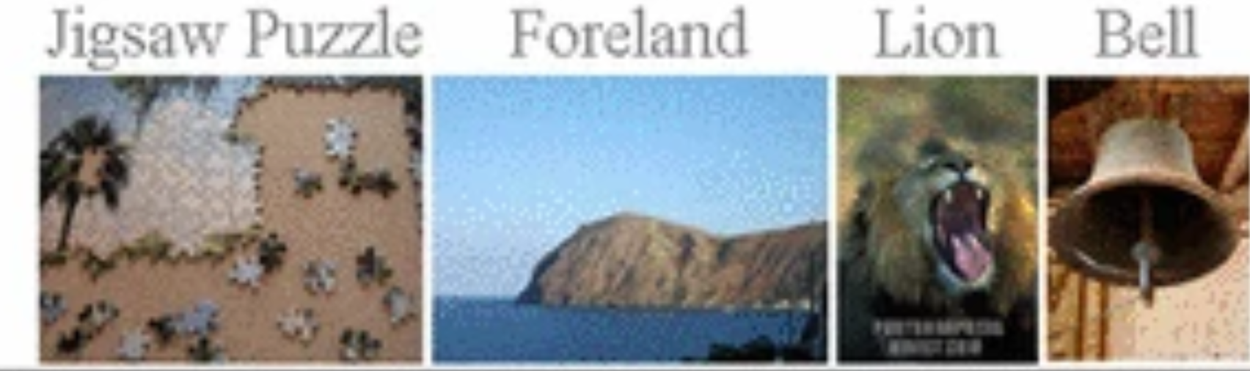
What’s a good output representation?
Discuss in depth later in the course
For now, features that a linear classifier/regressor is effective on
Consider ImageNet classification:
Original pixels – terrible representation (linear classification accuracy <10%)
Neural network – much better (linear classification accuracy >90%)

Slide 11
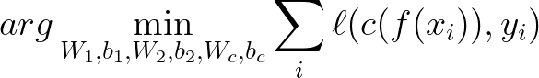
How do we know what weights to use?
Find best weights, given network architecture and training dataset
For example:
our encoder is a 2-layer network, params W₁,b₁,W₂,b₂
Our linear classifier has parameters W_{c},b_{c}
The optimization problem becomes:
The weights are obtained by optimization (e.g. SGD + momentum)

Slide 12
FC Networks Do Not Scale
Suppose the input was an image (10⁶ pixels)
Objective: map it to semantic representation

Slide 13
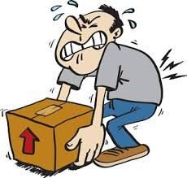
Option #1: Keep Input Dimension
All layers have output of same order as input
When input 10⁶ pixels and output 10⁶ neurons – 10¹² weights
Computational cost is extremely high (very slow)
Memory cost is extremely high (cannot store in RAM or disk)

Slide 14
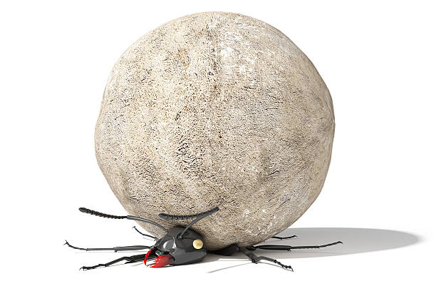
Option #2: Severely Compress Dimension
Only feasible option: output is much lower dim than input
First layer already compresses image X1000
Such heavy compression using a linear layer loses too much info

Slide 15
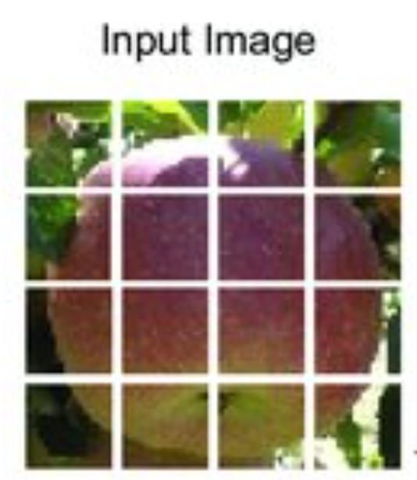
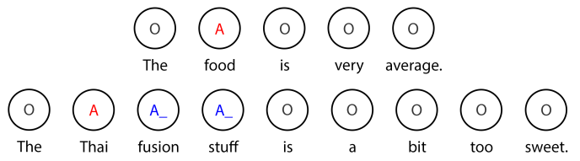
A Better Approach: Tokenize Input
Do not treat the entire input as one vector
Insead, split it into multiple “tokens”
Input features for each tokens

Slide 16
Run FC Network on Each Token
In each layer, we run a FC layer on each token
Complexity is ok – params 10⁶, compute 10⁹
Cannot model correlations beyond each token

Slide 17
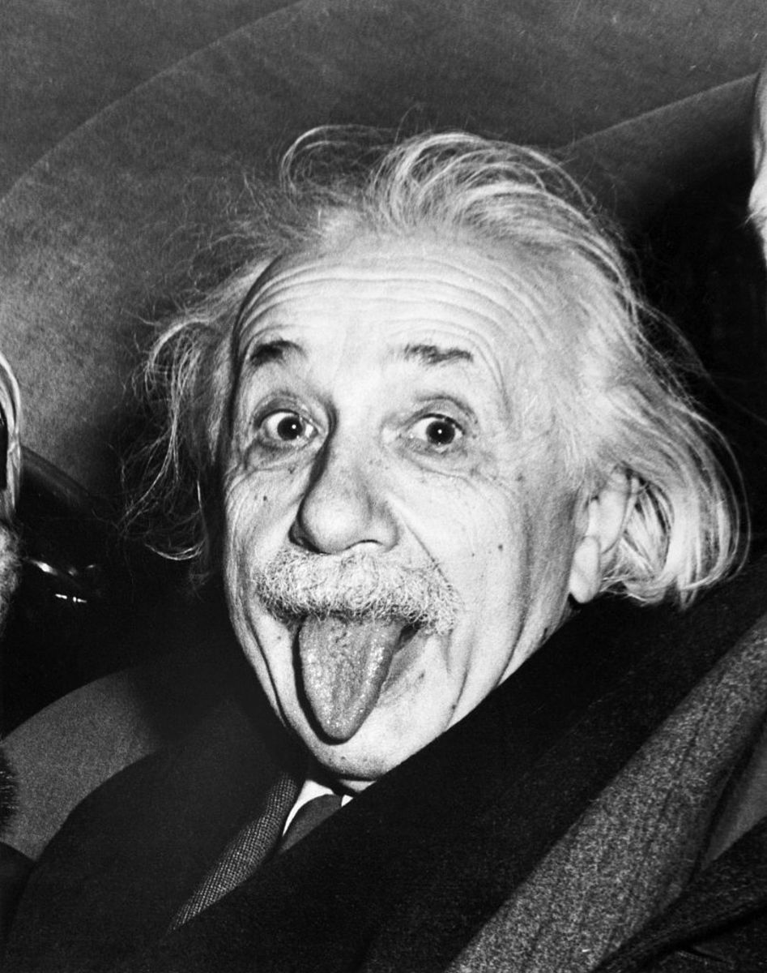
Adding Context Information
For each token i:
Retrieve other tokens relevant to token i - context
Aggregate the information of the context tokens
Add original token i information with context information
Run FC network on this feature

Slide 18
Local Context
The simplest idea is to use the neighboring M*M tokens
Motivation: nearest tokens are most relevant for understanding

Slide 19
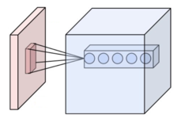
Convolutional Layers
Per-token context – concatenation of features of M*M nearby tokens
t(i) = [f_{i-1,j-1}, f_{i,j-1} , f_{i+1,j-1} , f_{i-1,j} , f_{i,j} , f_{i+1,j} , f_{i-1,j+1} , f_{i,j+1} , f_{i+1,j+1}]
FC layer operated per-token on the combined feature
t(i) <- max(0, Wt(i) + b)

Slide 20
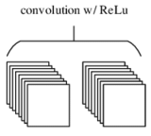
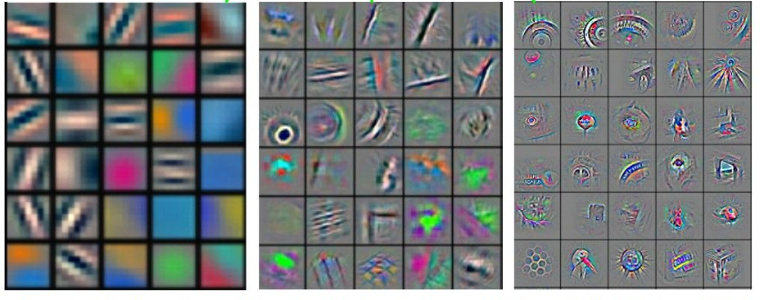
Stacking Conv Layers
A single conv layer can only learn simple patterns
More complex patterns by stacking multiple conv layers
E.g. first layer detects edges, second layer detects corners etc.

Slide 21
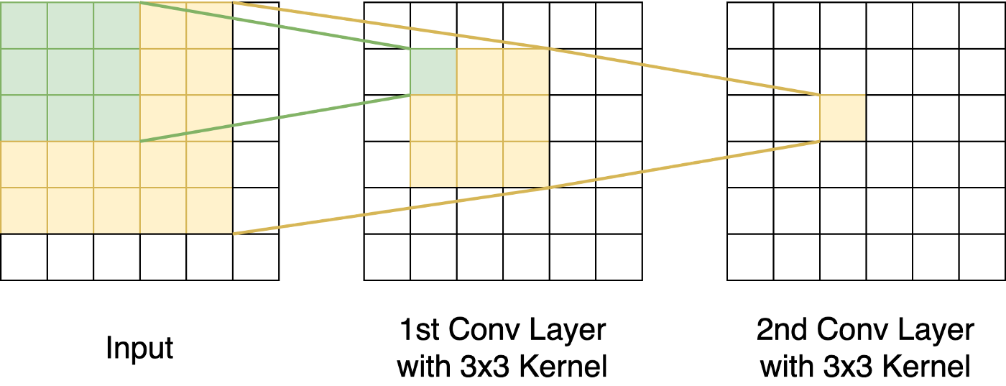
Limited Context
Stacking up conv layers increases receptive field very slowly
This means the left eye token is unlikely to see the mouth token

Slide 22
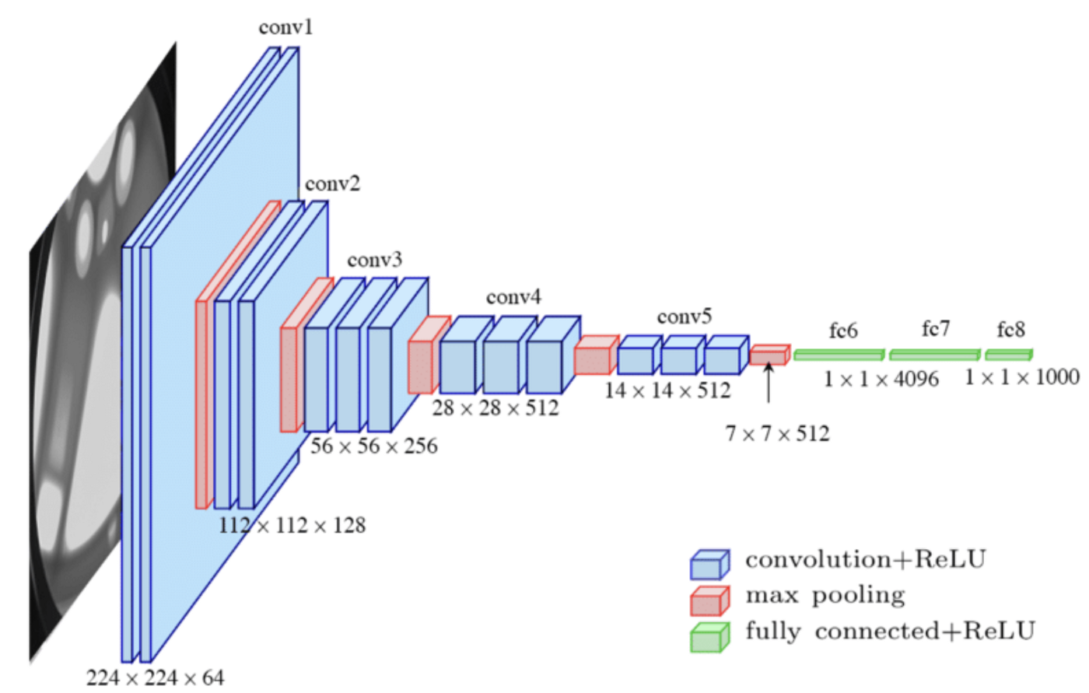
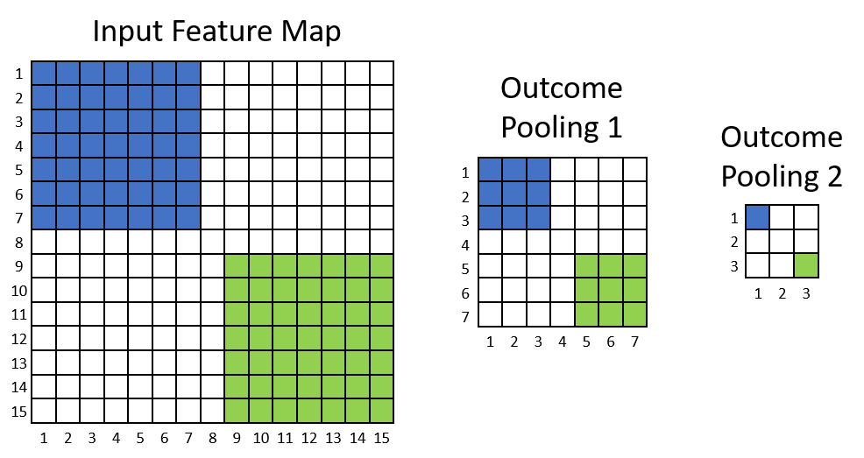
Feature pyramids for largest context
Idea: pooling (downscaling) the data after a conv stack
E.g. take the average of every 2X2 patch
This reduces the number of tokens by 4
Increases the receptive field by a factor of 2 in each direction

Slide 23
A look at a full conv neural network
Typical architecture:
A stack of convolution layers linear models for small 3X3 patches)
A pooling layer
[X4]
A classifier

Slide 24
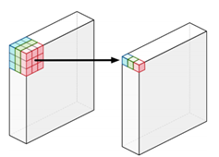
Token Averaging Instead of Concat.
Traditionally, conv layers concatenated features of all neighborhood
Becomes very expensive to have large neighborhoods, use 3X3
Recent methods simply compute a learned weighted average
Denoted “depthwise convolutions” – scales to large neighborhoods

Slide 25

Does Context Have to be Local?
CNNs use local context, in pyramids
A good fit for many image tasks, but not so general
How can we capture global context efficiently?

Slide 26
Self-attention layers
A more advanced way of looking at large context
Start with a set of token features
Map each token feature into three z -> (key , query, value)
z
k = W_{k}z
q=W_{q}z
v=W_{v}z

Slide 27
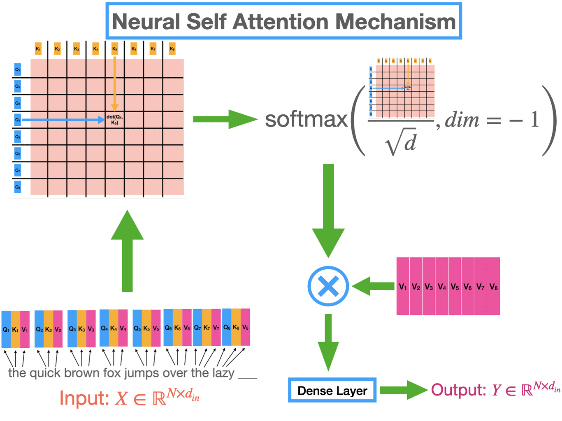
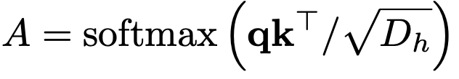
Self-attention layers (2)
Compute self-attention by:
Computing the dot product between a token’s query and all keys
Passing the result through a softmax layer resulting in probability
The probability vector is called attention

Slide 28
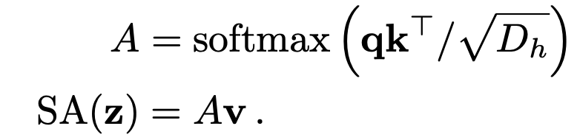
Self-attention layers (3)
The context for each token is given by a sum of all value vectors, weighted by the attention

Slide 29
Using the Global Context
We can now combine the global context with the token features
E.g. z + SA(z)
We now apply the FC layers on the features of each token

Slide 30
Differences Between the Contexts
Standard CNN:
Small local context becomes global via pyramid
Concatenation
Modern CNNs: large local context
Large local neighborhood
Weighted averaging (weighting per each dimension, per context token)
Transformer
Adaptive global context
Weighted averaging, but weighting in per context token, not per-dimension
Last limitation can be mitigated by multiple attention heads, out of scope.

Slide 31
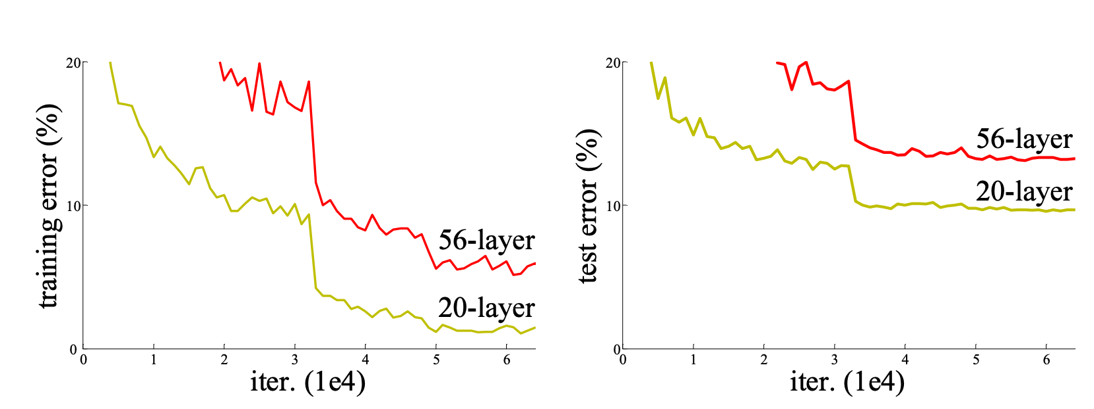
Optimization issues
It turn out that once neural networks get deep optimization fails

Slide 32
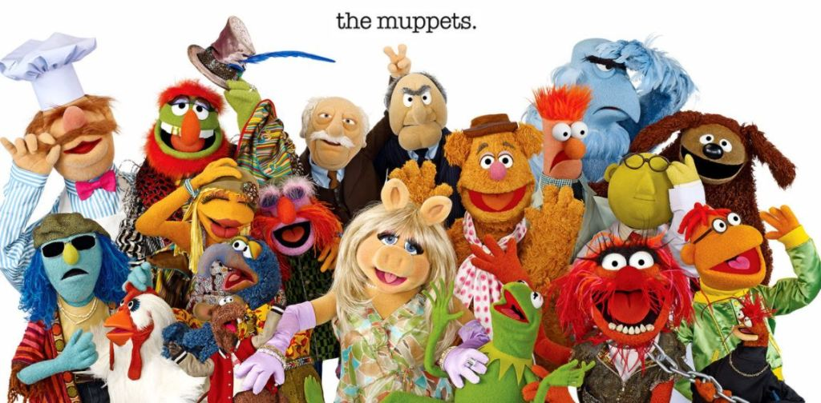
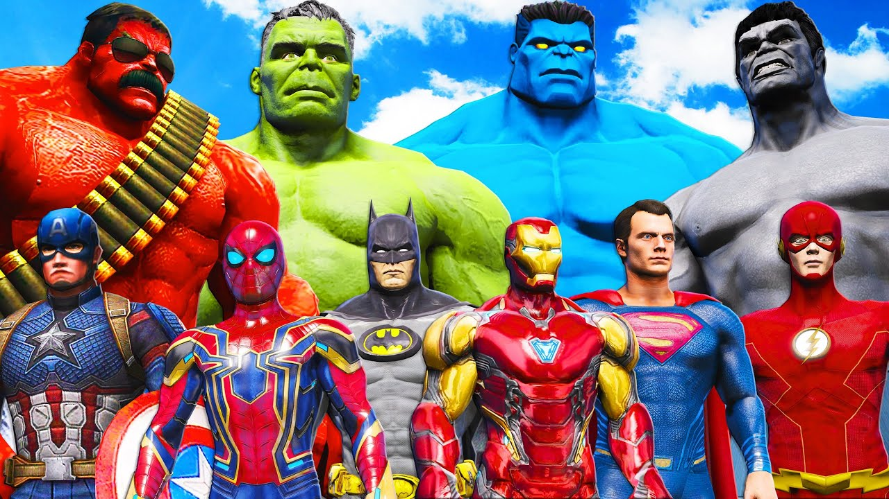
Why did that happen?
Credit assignment through poorly intialized layers
Consider:
You are a bad employee in a large factory where everyone is a superhero
You are a bad employee in a large factory where everyone is a muppet
Where would the manager be able to give feedback?

Slide 33
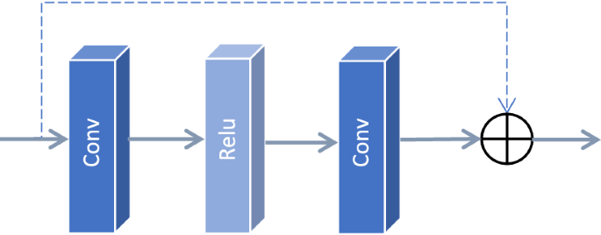
Residual connection
Idea: provide direct feedback from the output to each weight
Implemenation: residual (skip) connection
E.g. f(Ux) = ⍺ max(W₂max(W₁(Ux) + b₁, 0)+ b₂ ,0) + Ux
Layer Scale
*⍺

Slide 34
Multiple Residual Blocks
⍺ is initially small
At first approximation the input to each block is the input x
A deep ResNet initially approximated as ensemble of shallow blocks
Easy to optimize!
*⍺
*⍺

Slide 35
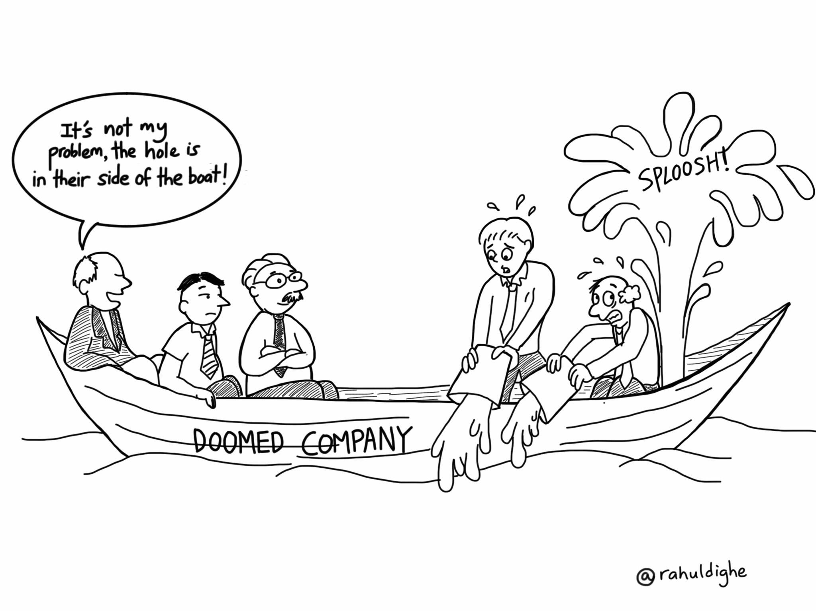
Normalization
SGD works better for well conditioned data (e.g. normal distribution)
The cumulative effect of multiple layers can result is large numbers
Even a single layer blowing up can hurt optimization

Slide 36
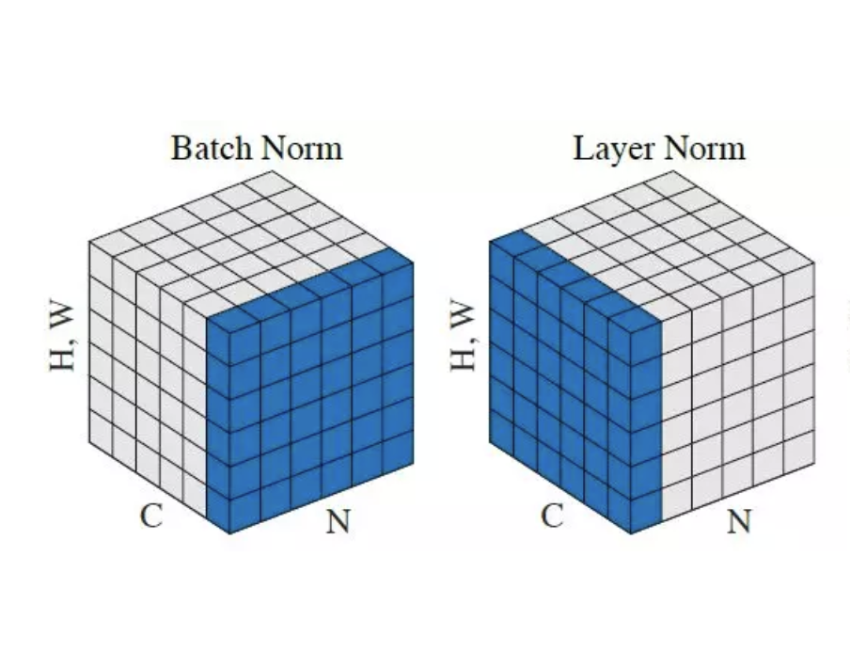
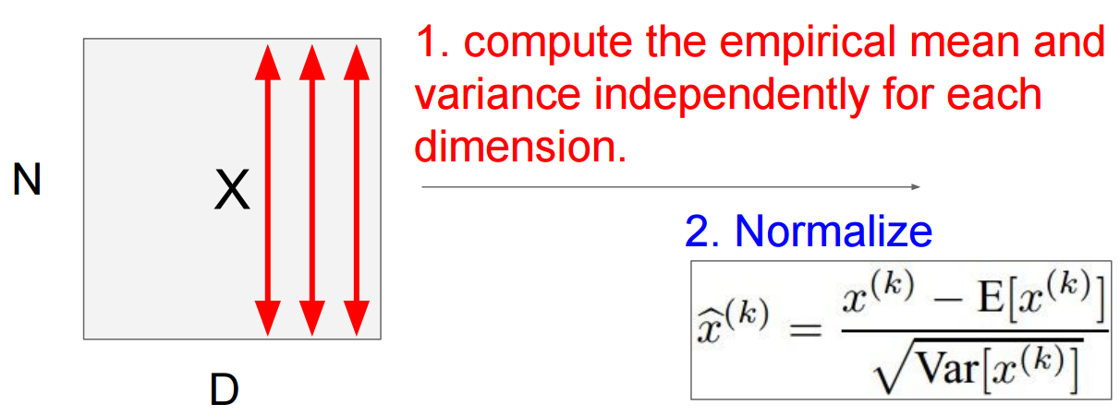
Batch/Layer normalization
The output activations for each channel normalized by mean and std
Layer norm: compute stats across all pixels of a single example
Batch norm: compute stats across all pixels of a multiple examples

Slide 37
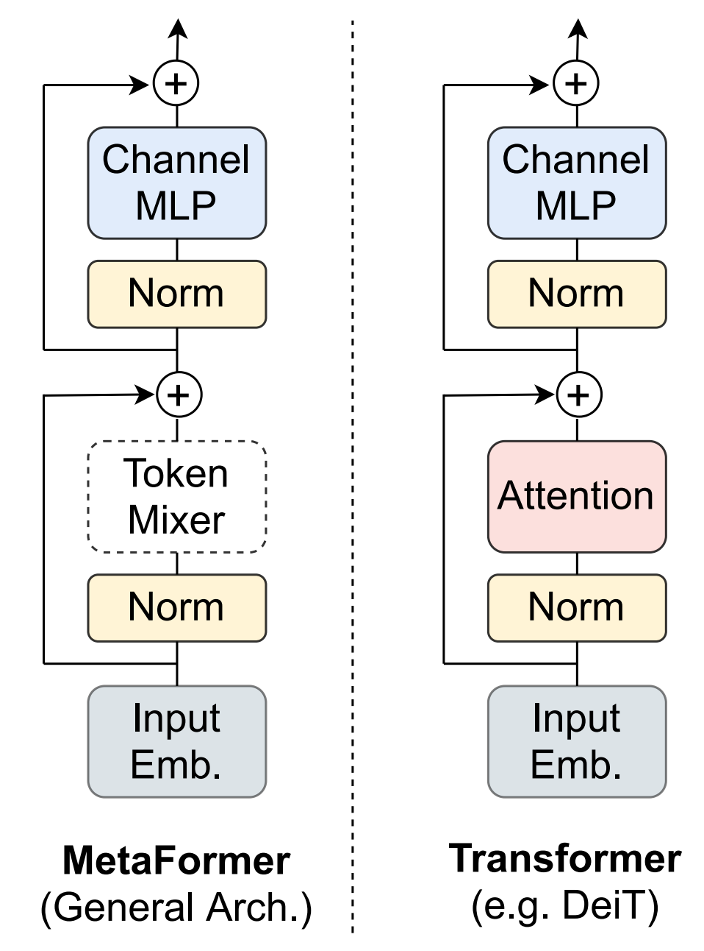
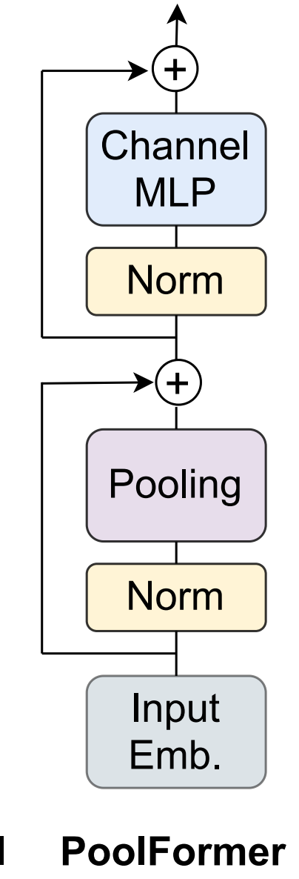
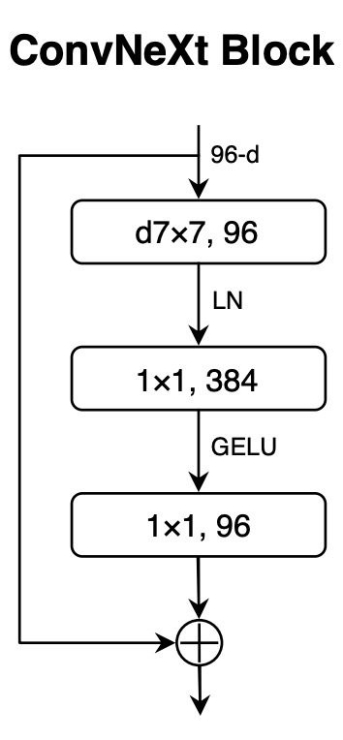
Final Blocks
https://github.com/lucidrains/vit-pytorch/blob/main/vit_pytorch/simple_vit.py
https://github.com/facebookresearch/ConvNeXt/blob/main/models/convnext.py
ConvNeXt – uses a very simple weighted average context, so skipped its norm and skip connection

Slide 38
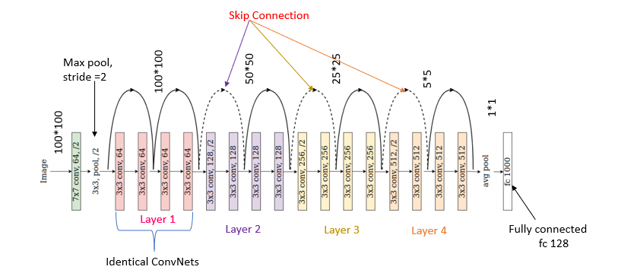
A full residual neural network
This network has 18 layers (it’s a small one, it can have >1000 layers)

Slide 39
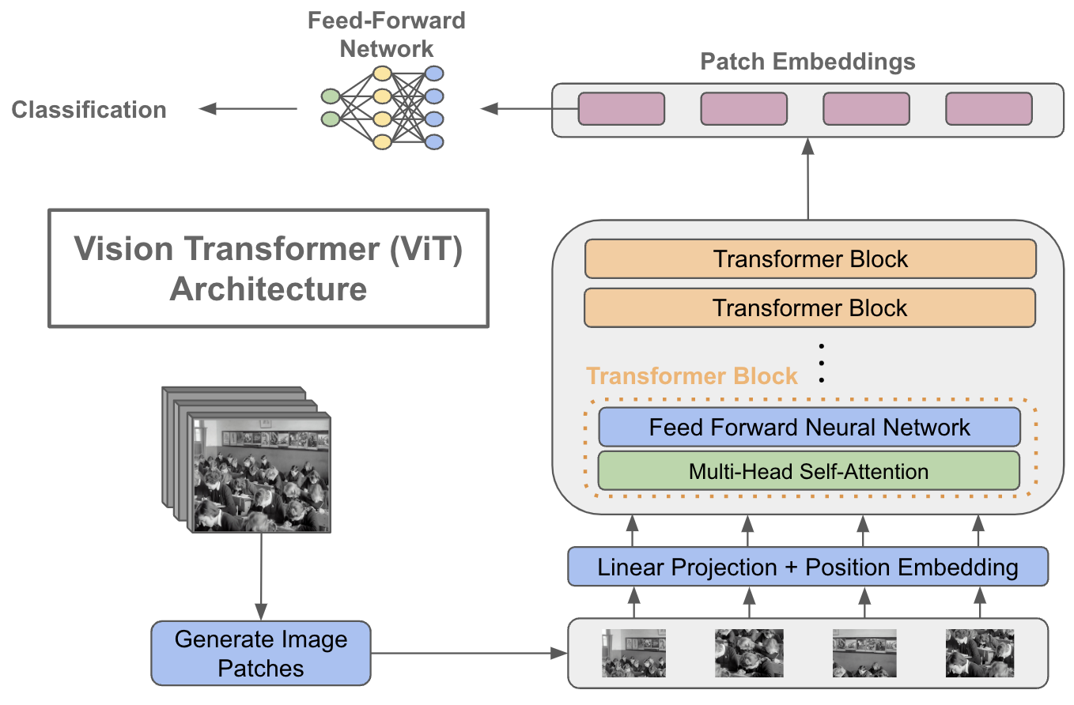
A look at a full transformer
Stack of SA + MLP
Classifier on final token
Single resolution

Slide 40
Summary: global context modeling
Two ways of reaching global context with few params
CNN: look at local patches,use multiscale for larger context
Transformer: use self-sttention to encode the relevant context

Slide 41
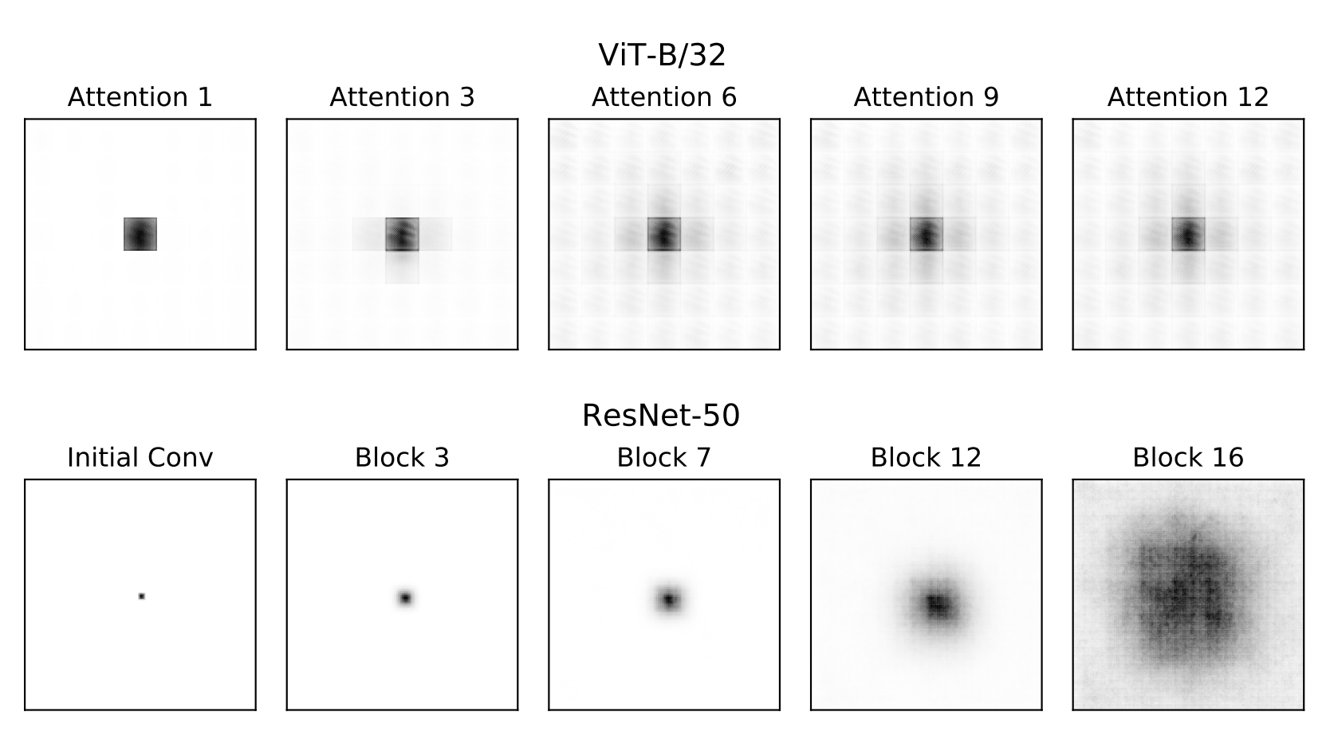
Visualization of the receptive fields
Transformer receptive field is global from early on
CNN receptive field grows gradually

Slide 42

Inductive Bias vs. Expressivity
Transformers: very expressive
CNNs: special case of transformers
Too much expressivity: overfitting
The right kind of expressivity: positive inductive bias
CNNs: better on small image datasets, transformer on larger ones

Slide 43
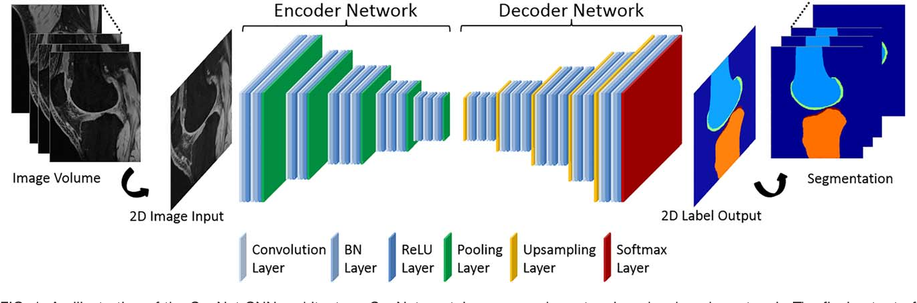
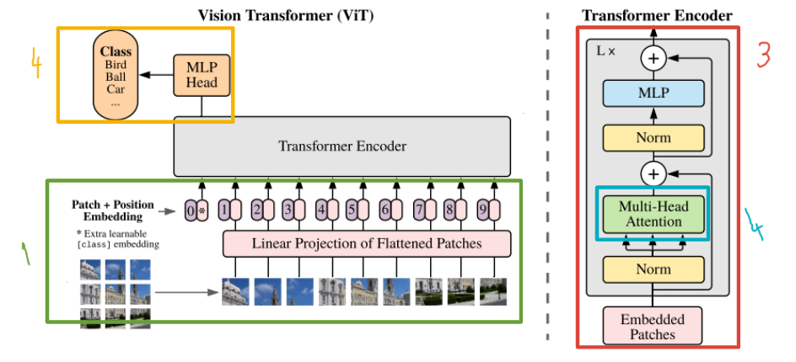
Neural network patterns - encoder
Map raw representation to semantic deep representation
In CNN typically also downscaling

Slide 44
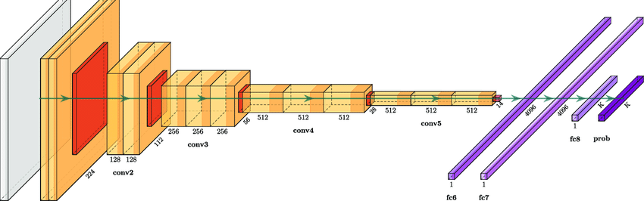
Neural network patterns - classifier
One or more FC layers mapping deep representation to class

Slide 45
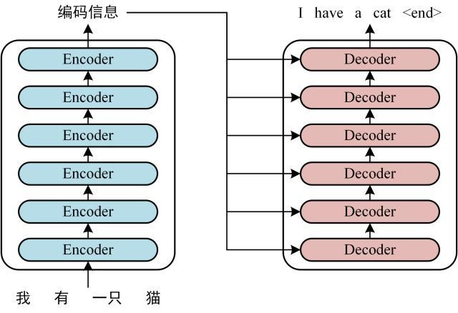
Neural network patterns - decoder
Map deep representation to output data
In CNN there is typically also upscaling

Slide 46
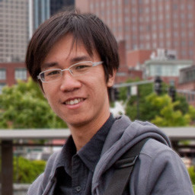
Choosing Neural Architectures in Practice
Don’t invent new architectures unless you have to
Much better to borrow architectures from similar problems
There are very few architecture that passed the test of time
Probably more than 10000 were proposed, so chances aren’t good

Slide 47
Example: Supervised Image Classication
A transformer for image classification – for large datasets
Input: ImageNet dataset (1M images), label 1 of 1000 object classes

Slide 48
Challenges: Using Transformers for Images
Input to transformer should be no more than 1000 tokens
Solution: split image into 16X16 tokens (each is a 14X14 image patch)
Output is a set of token activations – how to combine classifier?
Solutions: i) average token embedding ii) add special solution token

Slide 49
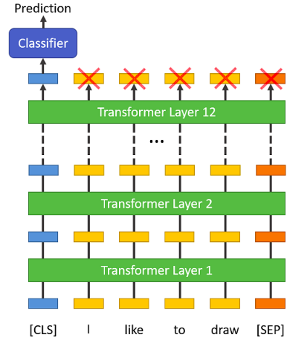
Example: Supervised Text Classication
A transformer for image classification – for large datasets
Input: sentence dataset, label 1 of 10 sentiments
Tokenization: either every word is a token, or sub-word units

Slide 50
Example: Supervised Speech Classication
Input: speech command dataset, label 1 of 10 commands
Tokenization: extract spectrogram features from every 100 ms of audio

Slide 51
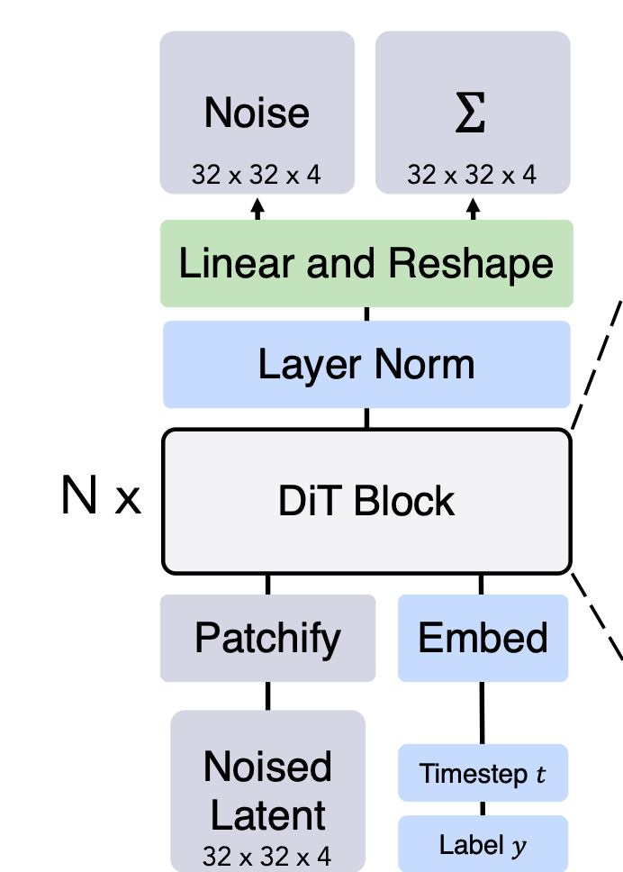
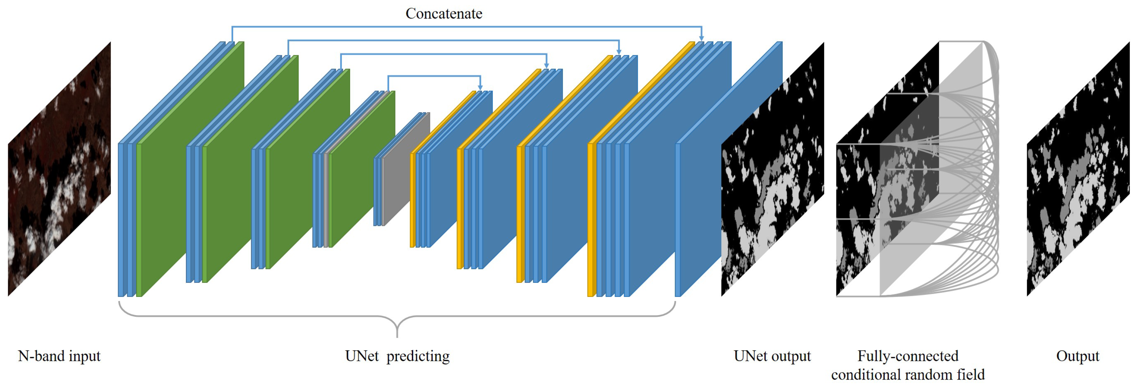
Example: Image-to-Image
Challenge: architecture when input and output are images
Two ideas:
Tokenization – followed by transformer
Unet – encoder-decoder with skip connections

Slide 52
Conclusion
Deep architectures are converging
Global context without too many parameters
Lots of effort required for hyperparameter tuning
New tasks require clever tokenization

